Slide 1



Bereavement And Loss
How the Coronavirus pandemic has affected us all

Slide 2
Aims
To allow staff time to explore and reflect on the following:
Loss in the broadest sense and how it affects us
Children’s understanding of death
The grieving process
Bereavement and the impact the current pandemic is having on people’s grief
Skills relevant to your role and organisation that can help you communicate with, and support, bereaved individuals

Slide 3
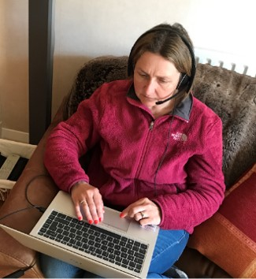
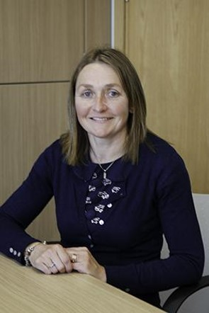
Introduction

Slide 4
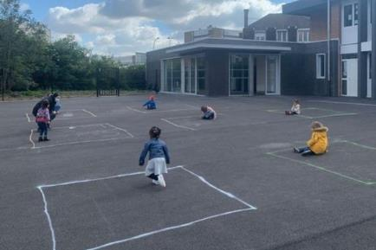
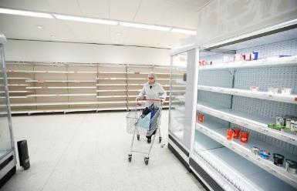
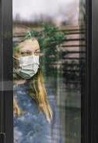

Loss
Lockdown has imposed a series of losses for us of everyday things we previously took for granted. The loss of our freedom, routine, social connections and fun. Most of all we have lost control and are subject to restrictions imposed for our own good that we have no say over.

Slide 5

Facing up to death
Fear of the unknown
Fear of being out of control
Fear of no discernible way out
Fear of someone we know dying
Fear of dying ourselves
Fear of dying alone
Worry about what will happen to others if we do die
IT’S OKAY TO NOT BE OKAY!

Slide 6
The concept of death
Universality - death is a natural phenomenon. It is inevitable and no living thing can escape it
Causality – there is a reason or cause of death
Finality - cessation of all body functions. Death is final, everything stops
Irreversibility - death is a permanent phenomenon. No recovery, no return

Slide 7
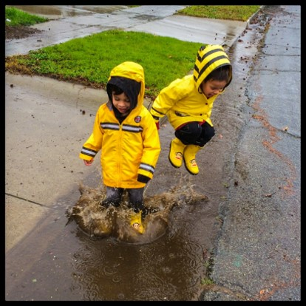
Children’s understanding of death
Here is a very brief outline of typical interpretations at different developmental stages:
Babies can easily pick up a sense of loss from their caregivers which has implications for attachment
Toddlers tend to develop a morbid fascination with death and dying
Infants get caught up in magical thinking but don’t have an appreciation that the person has gone forever, assuming that they have simply gone away
Children rarely pass when there is an opportunity for
a moment of joy

Slide 8


Junior school children gain a growing awareness as they come to appreciate the concept of irreversibility and permanence
Teenagers begin to think about the long term consequences and implications for themselves, their family and their future
Young adults tend to analyse and worry about their own mortality and may be more prone to experiencing depression

Slide 9
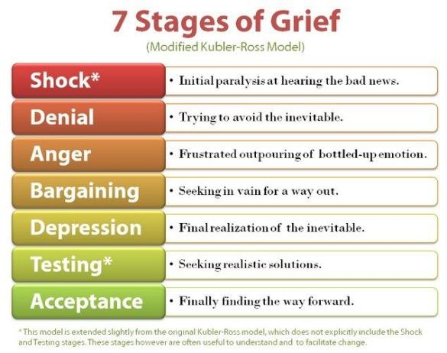
The process of grieving
Grief is as unique as you and as individual as a fingerprint.

Slide 10

What COVID-19 means for us
Lockdown
Social distancing
Self-isolation and shielding
Deaths - happening all over the world on a mass scale
Individual losses are being overshadowed by the crisis
Vulnerable groups, the elderly and certain communities are being targeted
The rapid onset of this virus is resulting in sudden, unexpected deaths
People may have witnessed or experienced trauma

Slide 11
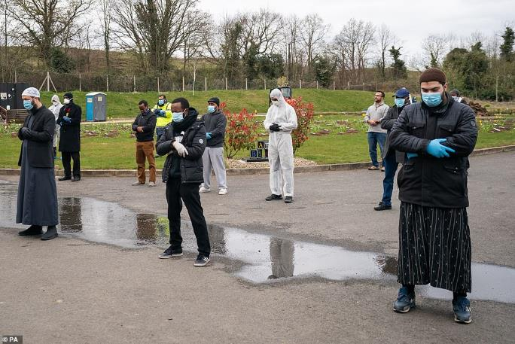
The impact of this on our ability to grieve
Lots of people are dying alone and there is no opportunity to say goodbye
Some families are experiencing multiple bereavements due to the nature and spread of the virus
Funerals are subject to tight restrictions
Family and friends are unable to grieve together and offer each other comfort

Slide 12
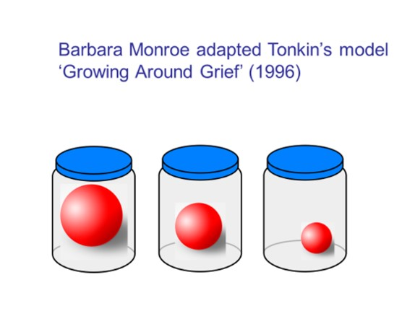
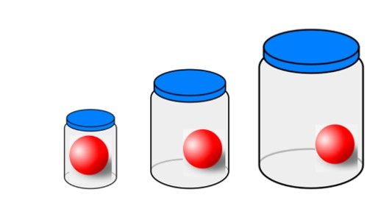
Models of grief

Slide 13
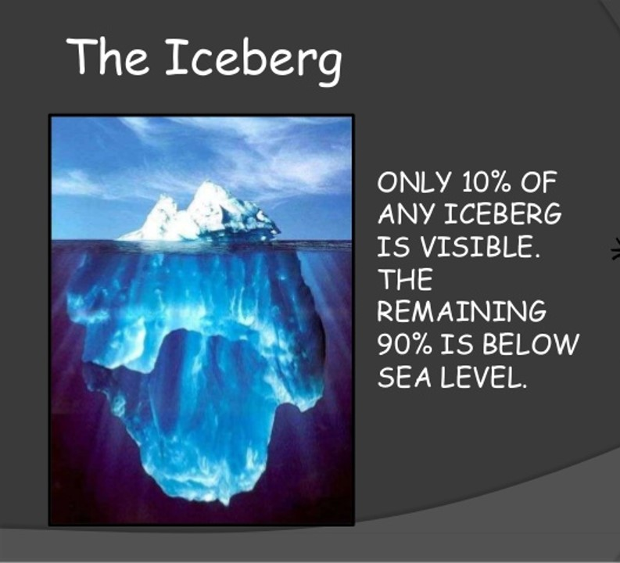
The Tip of the iceberg

Slide 14
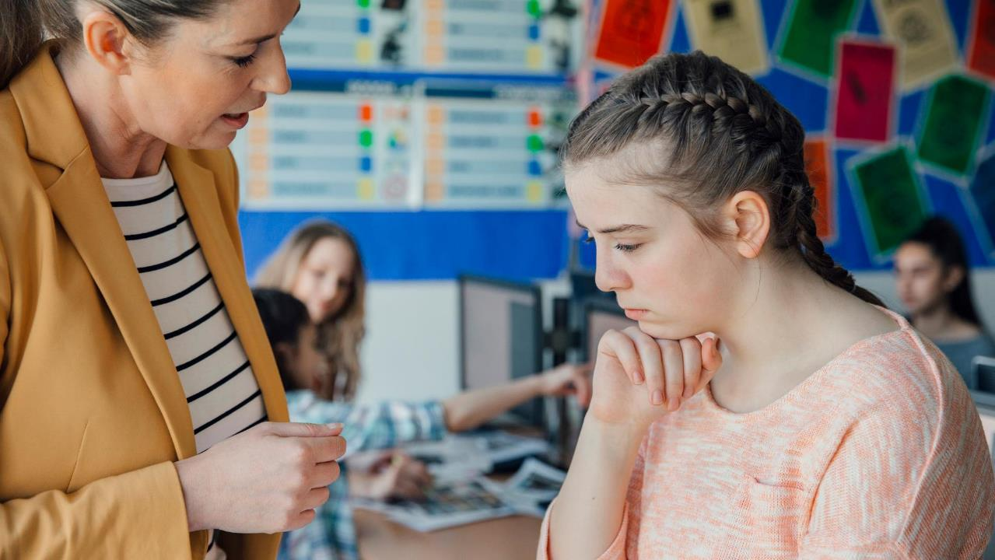
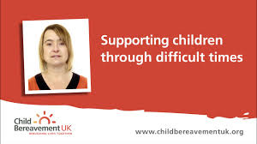

How to talk to children
Use plain, clear language
Avoid euphemisms
Be honest and factual
Apply the Goldilocks' Principle
Reassure them that their feelings are normal
Don’t try to cheer up and fix
Be prepared to have to repeat as they check things out – lots!

Slide 15
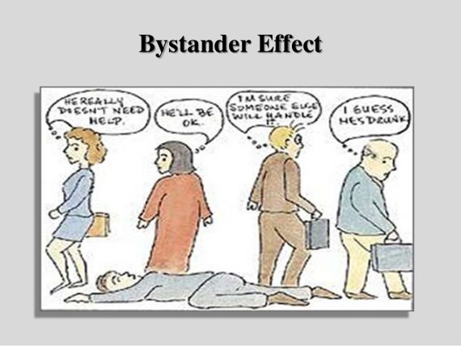
When words fail: What language to use
Here are some useful phrases when stuck for words:
“I’m sorry to hear that. That must be really difficult.”
“I honestly don’t know. I am just as confused as you.”
Or try the ‘wondering aloud’ technique:
- “I noticed that you seem angry…I wonder if...you are sad/worried about…”

Slide 16

Ten top tips
Rather than asking a closed question such as ‘Are you okay?’ Ask…’How are you?’
Be prepared to listen – if you ask, then you have to be ready to hear
Don’t brush questions aside – let them guide you
Avoid being shocked by blunt enquiry and seemingly trivial comments
Don’t underestimate anyone’s response – there should be no hierarchy of grief
It’s okay to cry – it shows that this is a normal grief reaction
Don’t be frightened to say you don’t know or don’t have an answer
Have a script ready and prepare for tricky questions
Seek supervision – be sure to debrief with a colleague
Know when to signpost and refer on

Slide 17
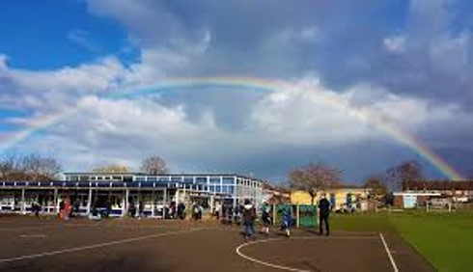
Moving forwards
Things to consider as schools, settings
and workplaces reopen:
Assess the damage
Share information – staff need to know if a student or member of staff has experienced a bereavement
Liaise with families – find out what would be helpful
Pause – allow some time for collective grief and ways to connect
Build relationships
Agree ways to acknowledge and remember what has occurred
Make space for creative expression

Slide 18
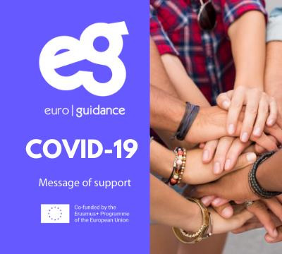
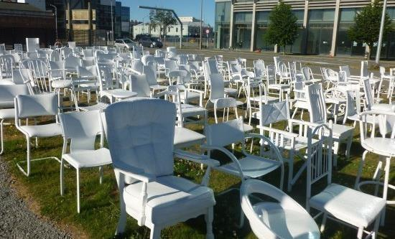

Remembering whilst Still restoring hope

Slide 19
Further Reading and Resources
The following websites have content specific to Coronavirus and have lots of useful tips for schools and families:
Child Bereavement UK https://www.childbereavementuk.org/pages/category/coronavirus
Winston’s Wish https://www.winstonswish.org/coronavirus/
Cruse Bereavement Care https://www.cruse.org.uk/get-help/coronavirus-dealing-bereavement-and-grief
Childhood Bereavement Network http://www.childhoodbereavementnetwork.org.uk/covid-19.aspx
Grief Encounter https://www.griefencounter.org.uk/serviceupdate/
Young Minds https://youngminds.org.uk/find-help/looking-after-yourself/coronavirus-and-mental-health/#i-have-lost-a-loved-one-due-to-coronavirus-

