Slide 1
Appendix 2
Existing Land & Properties

Slide 2
2a Laughton Road (burnt out building) and 3a Laughton Road (unused indoor market). View from Laughton Road (High St)

Slide 3
Colliery Band building to the right of image with indoor market behind. Outdoor market stalls, parking and refuse storage

Slide 4
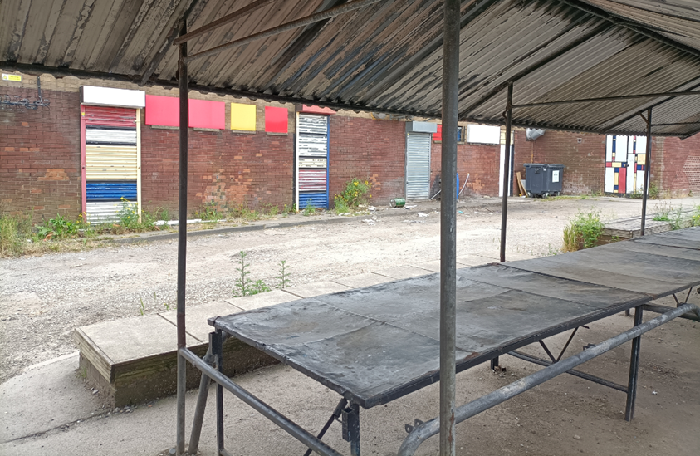
Fixed market stalls and rear 36-44 Laughton Road

Slide 5
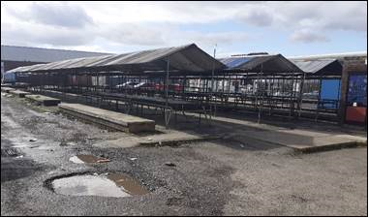
Fixed outdoor market stalls to the rear of Laughton Road. Pedestrian access from Laughton Road to bus interchange

Slide 6
Rear 36-56 Laughton Road, outdoor market

